Slide 1
DSC640 Project Part 3- Brett Sutow
File created on: 4/21/21 11:10:34 AM EDT

Slide 2
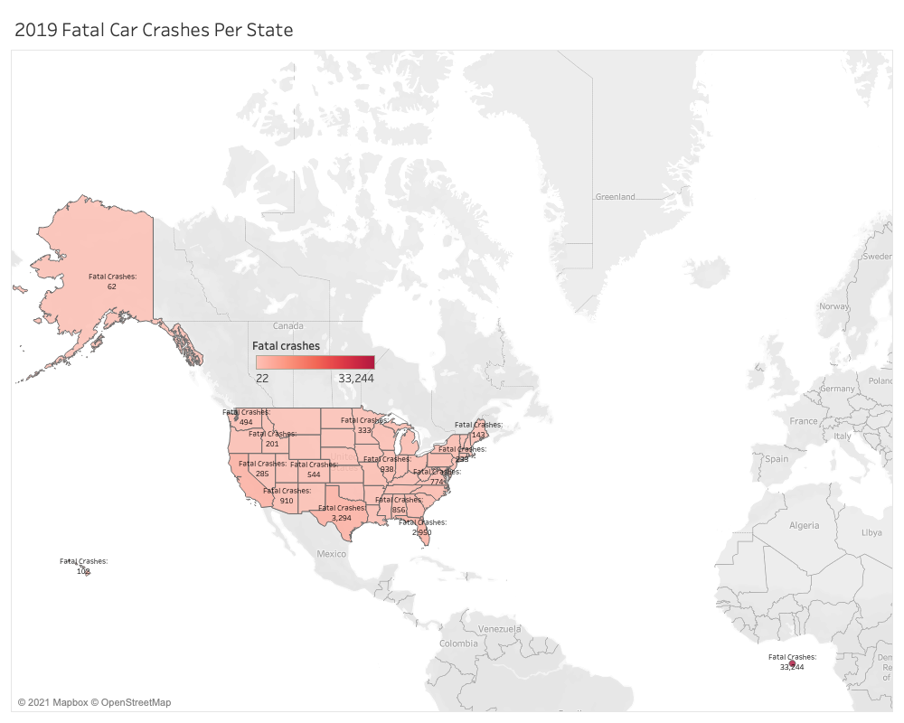

Slide 3
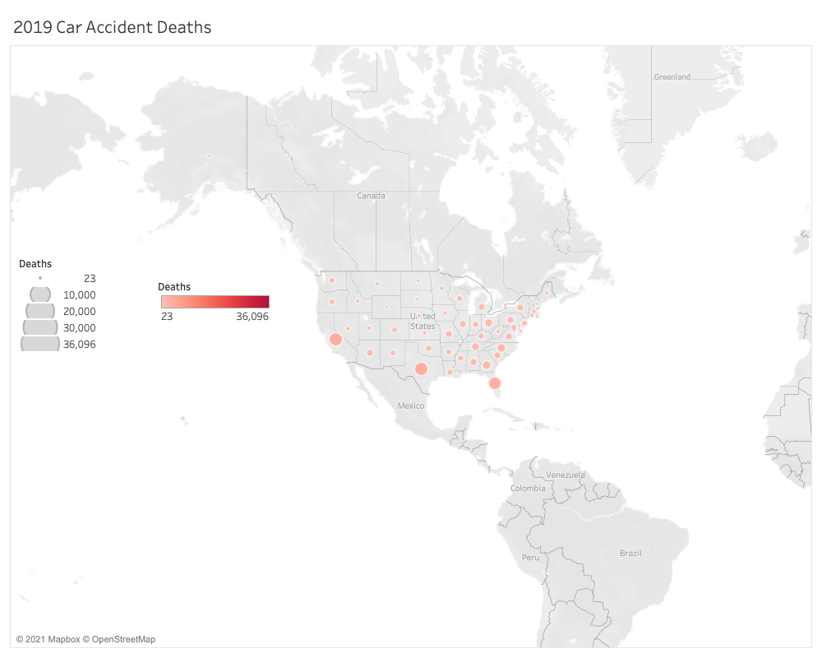

Slide 4
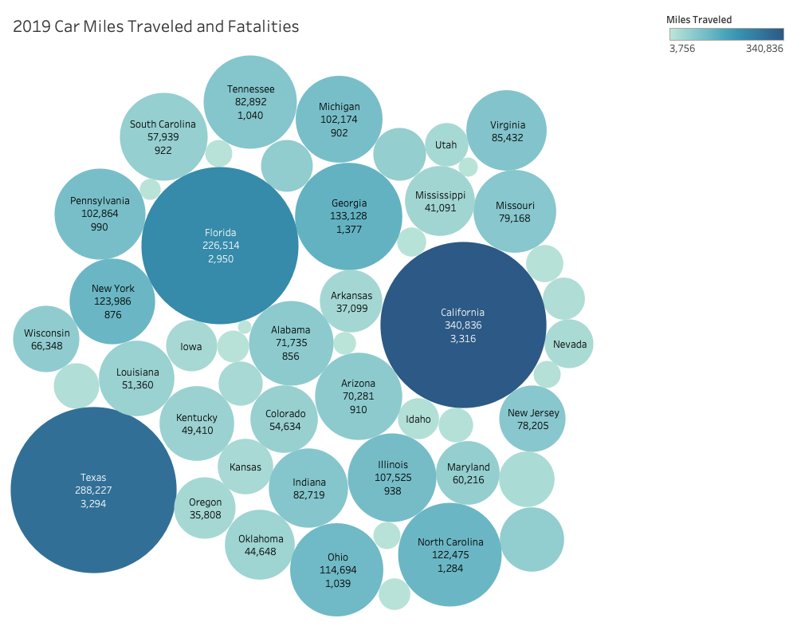

Slide 5
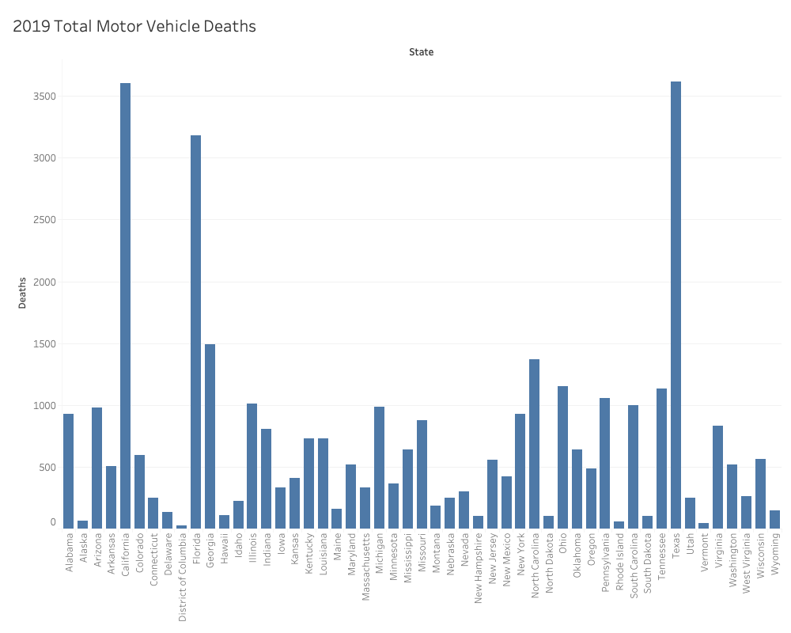

Slide 6
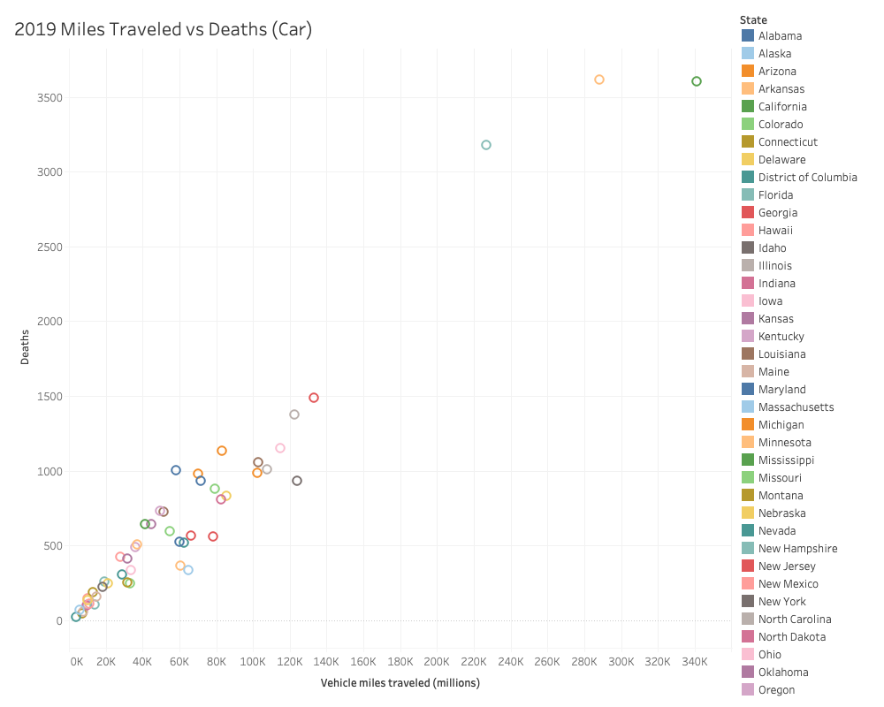

Slide 7
